Slide 1

Google
Quill
All
Images
Videos

Slide 2

Google
What is QUILL
Back to results
What is QUILL?
Quill is a web app that you can Create an account , Read others blogs , Update your posts and profile , Delete yours blogs
Our goal is helping people to discover themselves by giving them the space to write there own thoughts and ideas
Anyone can use QUILL no restrictions anyone have an idea or want to bring a new one can use QUILL
QUILL team members
In this section we will talk about quill team and the responsibly for everyone
QUILL Technical Architecture
In this section we will talk about quill Architecture Overview of the project's architecture, Technologies Used, Database Design.
Frontend Implementation
UI/UX Design Overview, Key Features and Components, Frameworks/Libraries Used

Slide 3



Google
Quill Team members
Back to results
Youssef Amr Front-end Developer
Hussein Amr
Back-end Developer
Youssef Ayman
Back-end Developer

Slide 4
Google
What is QUILL Technical Architecture?
All
Images
Videos

Slide 5
Google
What is QUILL Technical Architecture?
Back to results
What is QUILL Technical architecture?
Quill is a web app that you can Create an account , Read others blogs , Update your posts and profile , Delete yours blogs
QUILL technology used
The technologies utilized in the project is JSP, Servlets, HTML, CSS, JAVA, TOMcat
QUILL Database Design
Entity-Relationship Diagram (ERD) showcasing the database schema and key tables
Frontend Implementation
UI/UX Design Overview, Key Features and Components, Frameworks/Libraries Used

Slide 6








Google
Quill technology used
Back to results

Slide 7
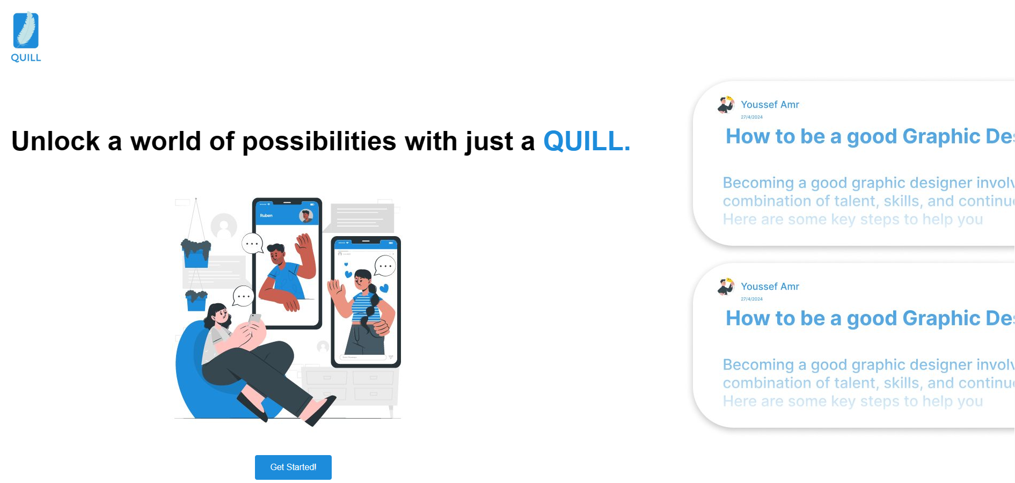
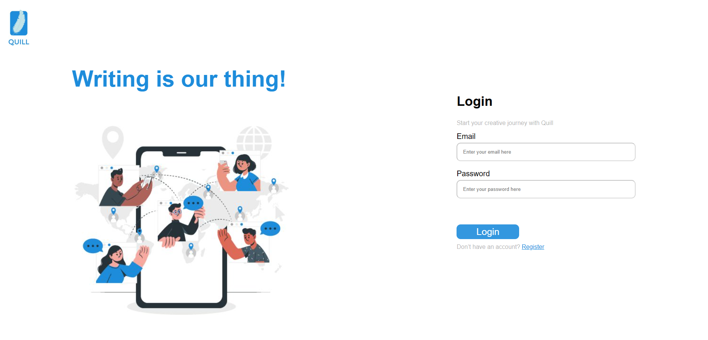
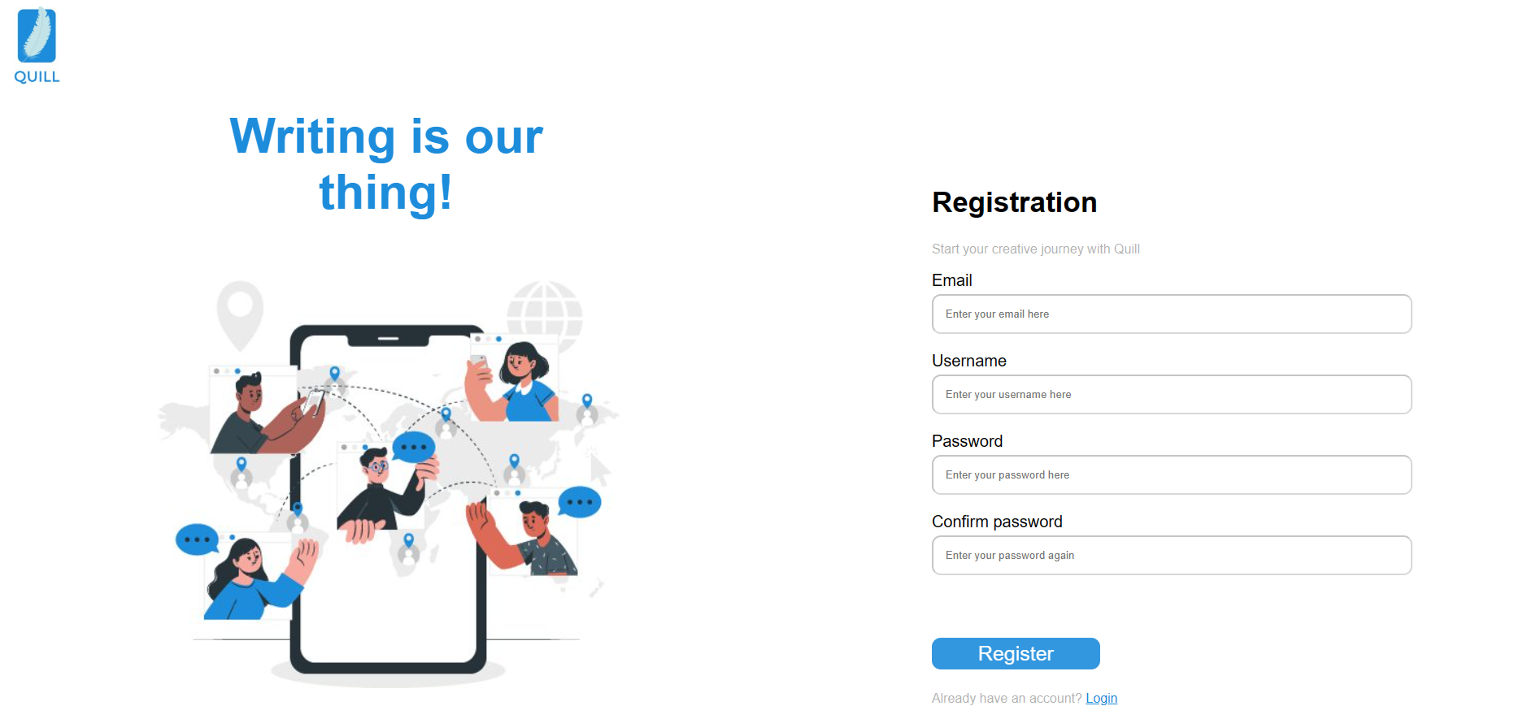
Google
Quill UI/UX Design
Back to results

Slide 8
Google
Quill Hero Page
Back to results

Slide 9
Google
Quill UI/UX Design
Back to results

Slide 10
Google
Quill Login Page
Back to results

Slide 11
Google
Quill UI/UX Design
Back to results

Slide 12
Google
Quill Registration Page
Back to results

Slide 13
Google
Quill UI/UX Design
Back to results

Slide 14
Google
How to use gamification
Back to results
Inspire
competition.
Identify what
should be gamified
Inspire
competition.
Encourage users to
challenge real friends.
Set the rules
(Keep it flexible)

